Slide 1
Paul George

Slide 2
Principal hypothesis/point of paper
Estimate the causal effects of mother’s or father’s schooling on infant birth outcomes (low birthweight, neonatal mortality, post-neonatal mortality, infant mortality)

Slide 3
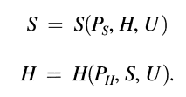
Why is this topic important?
Ways to improve infant mortality
Cost effective
Angus Deaton (2002) argues that policies to increase education in the United States, and to increase income in developing countries, are very likely to have larger payoffs in terms of health than those that focus on health care.
Observational studies of schooling and health are plagued by reverse causality

Slide 4
What is the contribution of the article to the literature?
Their estimation method corrects for biases due to endogeneity
Few prior studies that use IV to look at the impact of schooling in parents on their children’s health, and only 2 in LMIC

Slide 5
Data used
All birth certificates and death certificates for the years 1978-1999 (>300,000 births each year in Taiwan)
Low birth weight (<2,500 g), neonatal death, post-neonatal death, infant death (infant = neonatal + post-neonatal)
Mother and father’s DOB, county of birth
Women who were 0-20 years old in 1968
Data is aggregated into mother’s or father’s country of birth, cohort in 1968, and child’s year of birth (9,702 cells)

Slide 6
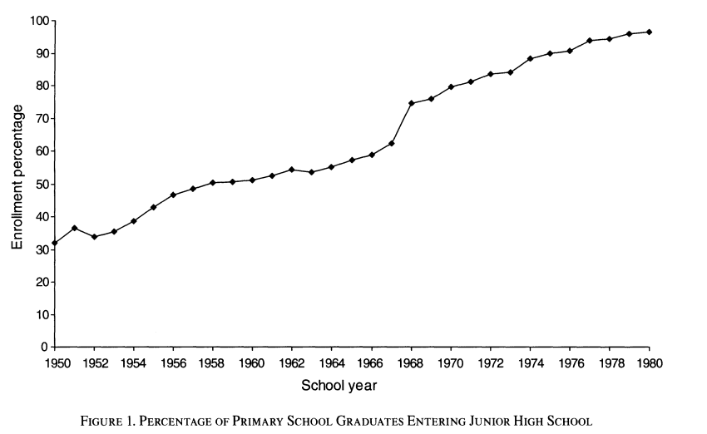
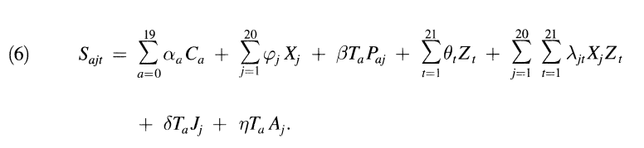
Methods
In 1986, the government of Taiwan extended compulsory education from 6 to 9 years, and opened over 150 new junior high schools at a differential rate among regions
The immediate impact was to increase the percent age of primary school graduates who entered junior high school from 62 percent in 1967, to 75 percent in 1968
Instrument for schooling: variations in junior high school openings across regions, e.g. program intensity
Notes:
Paj = Program intensity in county J and cohort a (e.g. 1-20, how old they were in 1968), Program intensity measure is cumulative number of new junior high schools that opened between 1968-1973 per thousand children
Ta = dummy that is 1 if a <12 in 1968, 0 otherwise
Ca = dummy variable for cohort a
Xj = dummy variable for county j
Zt = dummy variable for year of birth of child t
Jj = fraction of 12-14 year olds enrolled in junior high school in county j in 1967
Aj = fraction of workers in agriculture in county J in 1966

Slide 7
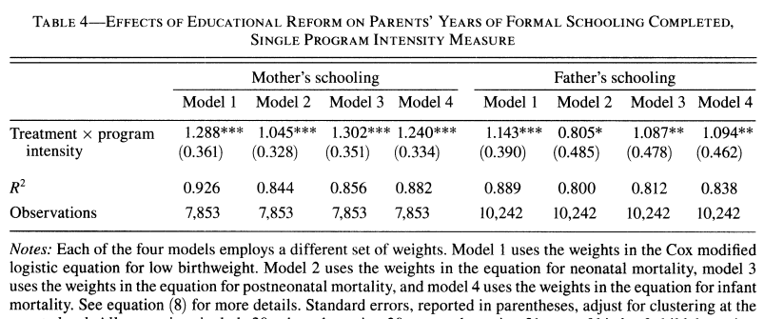
Results (instrument)
Notes:
Table 4 contains estimates of the effects of educational reform on mother's and father's years of formal schooling completed from the specification given by equation (6).
Model 1 = low birthweight; Model 2 = neonatal mortality; Model 3 = post-neonatal mortality; Model 4 = Infant mortality.
Taking into account the mean junior high school openings (0.20/1000), the effect of the reform is 1/4th year of schooling for females, 1/5th years for males.
F values all exceed 10

Slide 8
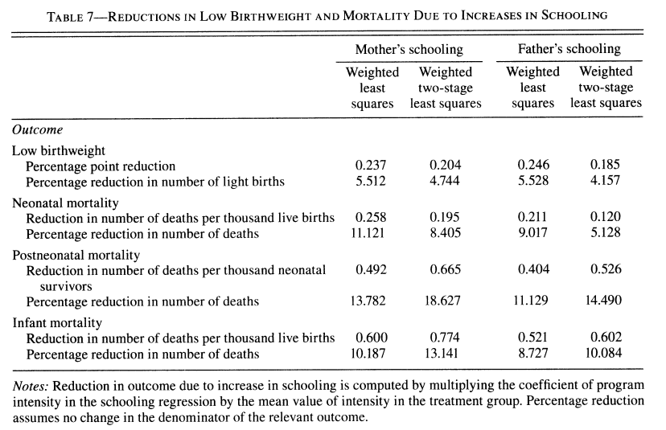
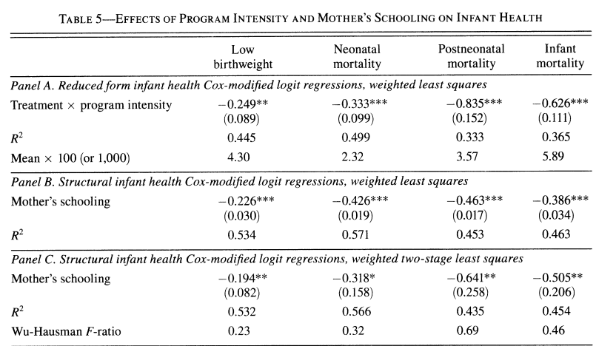
Results (infant health)
Notes:
Logit coefficients
Panel A: reduced form
Panel B: treats mother’s schooling as exogenous
Panel C: treats mother’s schooling as endogenous – “most interesting” note the standard errors are larger, but the estimates are similar. Results suggest that schooling can be treated as exogenous (as in Panel B).

Slide 9
Main conclusion
Schooling in mother and father causes favorable health outcomes in infants (high effect sizes for mother)
Schooling can be treated as exogenous?

Slide 10
Commentary
Was school roll-out associated with other indicators of economic development?
IV gives local average treatment effect – it is likely the more socially disadvantaged who reaped the benefits of increased schooling
Good use of natural experiment
Good explanation of their instrument

Slide 11
New research ideas
Other causal inference designs to test whether schooling can be treated as exogenous (e.g. Dynamic DiD, RD)
New Orleans post-Katrina

